Slide 1
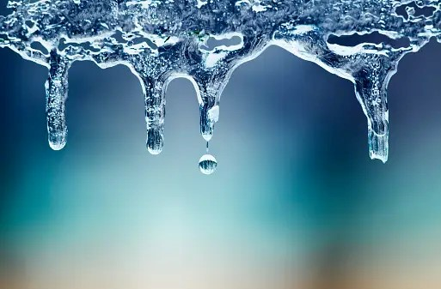
EXTREME COLD HARDINESS IN ECTOTHERMS
GROUP 13

Slide 2

OUTLINE
Introduction
Relevant terms
Cold Hardiness Mechanisms
Examples of cold hardy organisms
Conclusion
References

Slide 3
INTRODUCTION
We live on an environmentally diverse planet.
Temperatures on Earth can range from 56.7˚ C in Death Valley, USA to -89.4˚C in Vostok, Antarctica.

Slide 4
INTRODUCTION cont’d
Our focus will be on the colder regions.
Regions where conditions are described as “hostile” or “extreme” due to low temperatures.
A select group of species do reside in these environments, nonetheless.

Slide 5
INTRODUCTION cont’d
How are these species able to thrive in an environment where others would most certainly perish?
The answer lies in adaptation.

Slide 6
RELEVANT TERMS
Ectotherms – animals that rely on external sources of heat to regulate their body temperature.
Subzero temperatures – temperatures that are below zero degrees a scale, usually Fahrenheit or Celsius.
Cold hardy organisms – typically an ectotherm that has evolved specific adaptations enabling it to survive and thrive in subzero temperatures.

Slide 7
THERMAL ENVIRONMENTS OF COLD HARDY ECTOTHERMS
Avoidance often is an animal’s primary means to protection from extreme environments.
If migration to warmer climate is not an option, survival may depend on finding an overwintering site or hibernaculum.

Slide 8
Some toads and terrestrial turtles descend into the soil column and overwinter below the reach of frost.
In addition to being a thermally buffered site, an ideal hibernaculum;
conceals its occupant from potential predators
permits gas exchange
prevents excessive desiccation

Slide 9
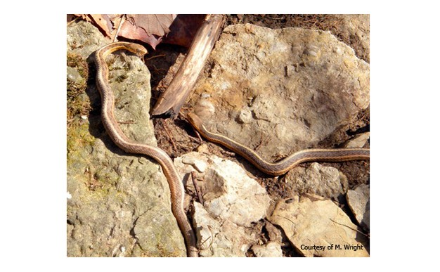
Garter snakes (Thamnophis sirtalis) emerging from a subterranean hibernaculum in late February.

Slide 10
COLD HARDINESS MECHANISMS
Typically related to internal body processes, these adaptations are essential for an organism’s survival. The strategies employed here are ;
Freezing Avoidance
Freezing Tolerance

Slide 11
Freeze Avoidance
A strategy used to prevent ice formation and harmful effects of freezing temperatures on the tissues and cells of certain organisms.
Supercooling is the main mechanism for freezing avoidance.

Slide 12
It refers to when an organism’s body fluids remain in liquid state below the freezing point.
This is achieved by;
minimizing ice nucleation
antifreeze proteins
cryoprotectants

Slide 13
Freeze Tolerance
A strategy used to endure freezing temperatures by allowing their body fluids to freeze, while having specific adaptations to survive. Achieved through;
controlled nucleation and growth
cryoprotectants
cellular dehydration

Slide 14
Class | Examples | Known From
Carbohydrates | polyhydric alcohols (glycerol, sorbitol, ethylene glycol); sugars (glucose, trehalose); cyclitols (myo-Inositol) | bacteria, marine and terrestrial invertebrates, amphibians, reptiles
Amino acids & derivatives | taurine, glycine, proline, alanine, asparagine, glutamic acid, lysine | bacteria, marine and terrestrial invertebrates
Methylamines | glycine betaine, glycerophosphorylcholine, trimethylamine oxide | bacteria, marine invertebrates, beetles
Urea |  | Terrestrial gastropods, amphibians, reptiles
Cryoprotectants used in animal freeze-avoidance and freeze-tolerance.

Slide 15
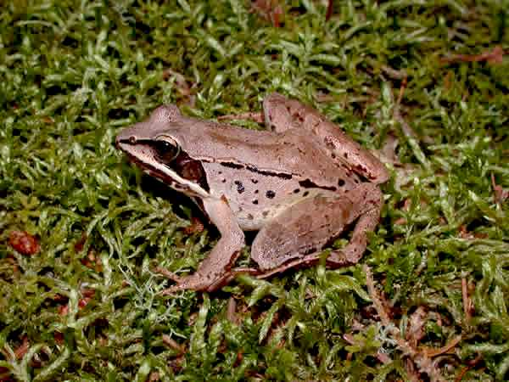
Wood frog (Rana sylvatica)
During winter, as temperatures drop, the wood frog undergoes cryopreservation.
A significant portion of its body freezes solid, including the brain, eyes, muscles and organs.
Wood frog (a freeze-tolerant organism)

Slide 16
It synthesizes and accumulates high concentrations of glucose and urea, acting as a natural cryoprotectant in its tissues.
These cryoprotectants lower the freezing point of the wood frog’s bodily fluids, allowing it to supercool.

Slide 17
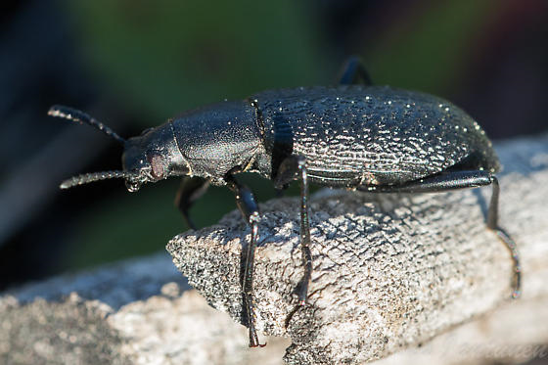
Alaskan Tundra Beetle (Upis ceramboides)
A strategy used by this organism is the accumulation of glycerol in its body as it begins to freeze.
Glycerol along with other cryoprotectants act as natural antifreeze agents that lower the freezing point.

Slide 18
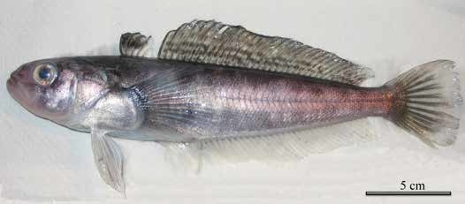
Icefish (Trematomus borchgrevinki)
One of its notable adaptations is the production of antifreeze proteins.
They bind to ice crystals and inhibit their growth.
This prevents the formation of large ice crystals that could be harmful to cells and tissues.
Trematomus borchgrevinki,a fish from a cryo-pelagic community. © Olivier REY, ICOTA-IPEV

Slide 19
Other adaptations include its reduced metabolic rate which allows the fish to conserve energy.
Also, ample fat reserves as an energy source during periods of reduced food availability.

Slide 20
CONCLUSION
Extreme cold hardiness in ectotherms is a remarkable adaptation for creatures in some of the harshest environments on Earth.
Freezing avoidance and freezing tolerance mechanisms provides valuable insights for scientific research and potential applications in various fields.
The incredible resilience of these cold blooded organisms and their role in maintaining the delicate balance of ecosystems in extreme climate must be appreciated.

Slide 21
REFERENCES
“Extreme Cold Hardiness in Ectotherms | Learn Science at Scitable.” Www.nature.com, www.nature.com/scitable/knowledge/library/extreme-cold-hardiness-in-ectotherms-24286275/.

Slide 22
GROUP MEMBERS
OPPONG, Ernest
OWUSU, Edward Peprah
OSEI-SARPONG Desmond
KESSE-BAAH, Enoch
AGBESINYALE, Emmanuella Sena
ANNAN-BONNY, Thelma
ADJEI, GLADYS

Slide 23
THANK YOU

